Slide 1
Investigating Drug Resistance in Prostate Cancer
The Lab Rats
Cammy Kutter, Ethan Cohen, and Sai Manikonda

Slide 2
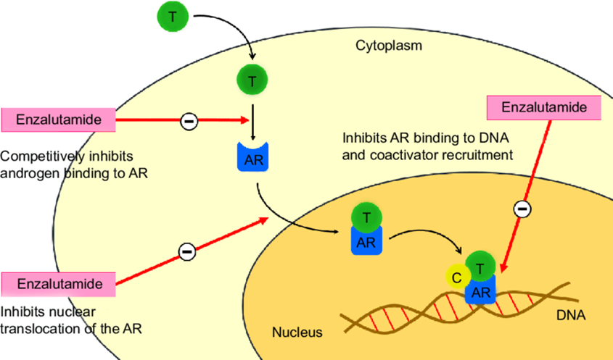
Challenge Question
Can we identify druggable genes and pathways that contribute to enzalutamide resistance?
Rodriguez-Vida et al. 2015. https://doi.org/10.2147/DDDT.S69433

Slide 3
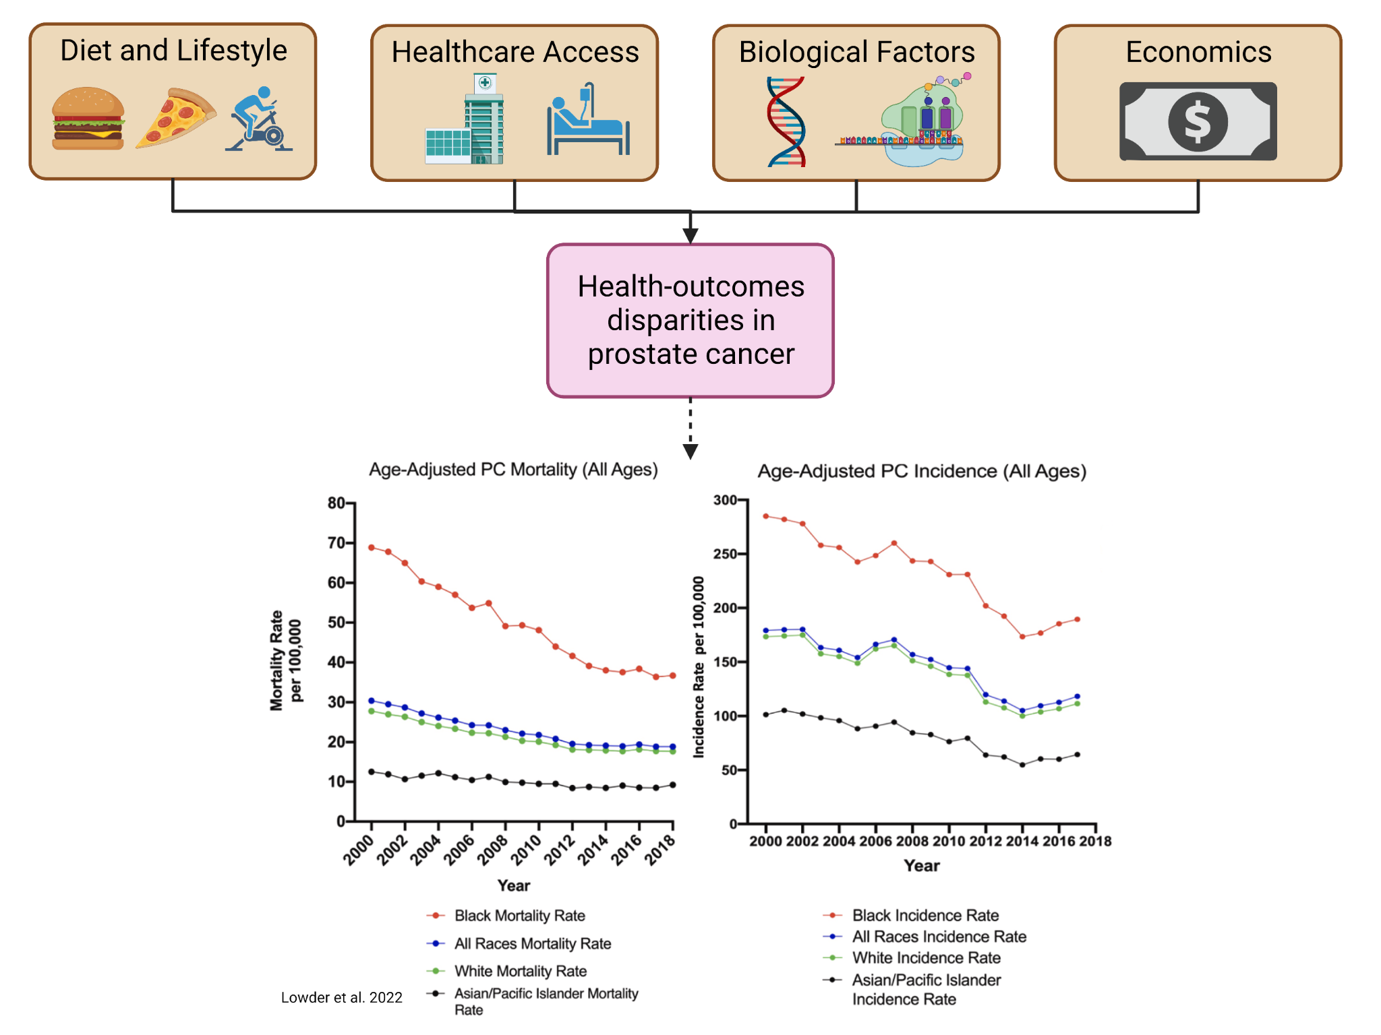
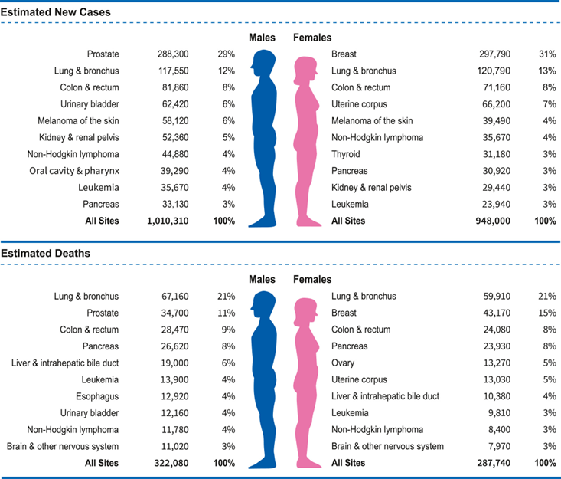
Prostate Cancer Data Exploration
Notes:
Prostate cancer is projected to be most common and second deadliest cancer for American men in 2023.
We see evidence for health outcomes disparities in prostate cancer incidence and mortality for African American men who suffer from almost twice the prostate cancer incidence and mortality.
Many factors play a role in in this health disparity, and our goal is to understand role biology may play in promoting emergence of therapeutic resistance in African American men with prostate cancer.

Slide 4
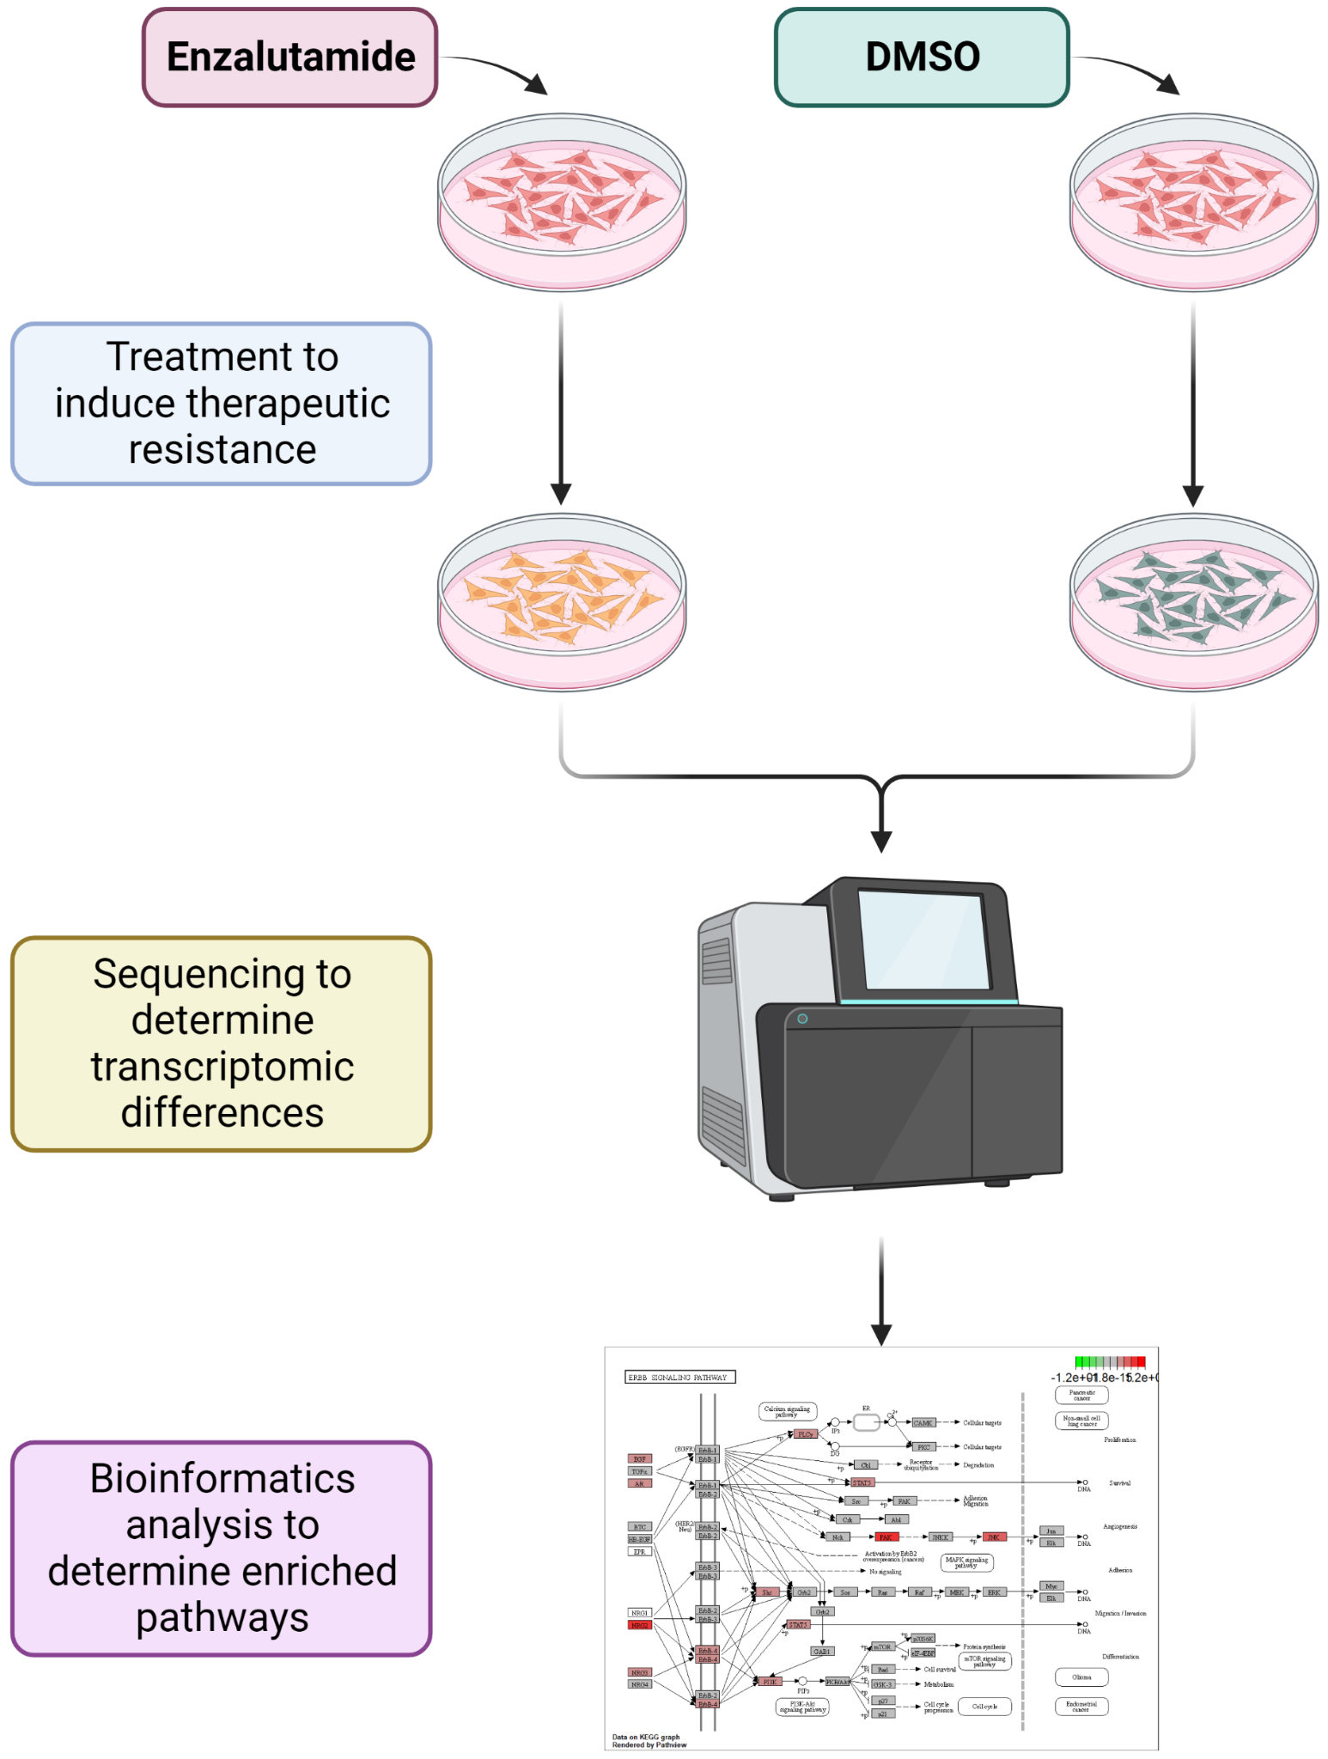
Data Production Experimental Design
Notes:
PCA-2B Cells were treated with either Enzalutamide or DMSO to induce therapeutic resistance
Cells were then sequenced to determine potential biological mechanisms behind the resistance

Slide 5
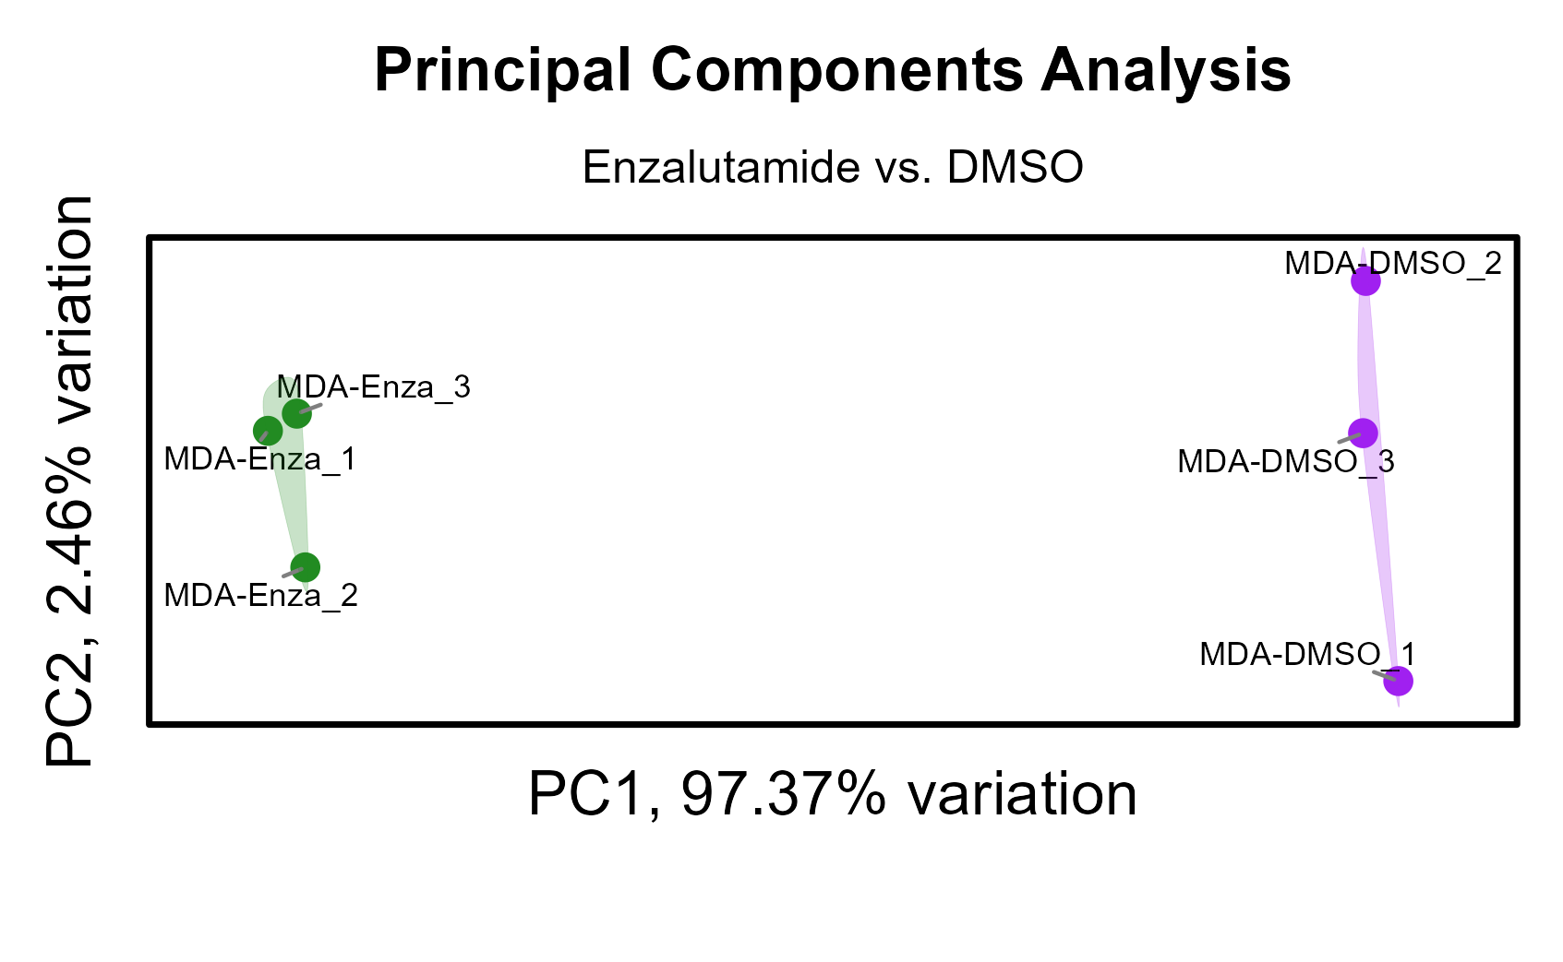
Verifying differences between the conditions with PCA

Slide 6
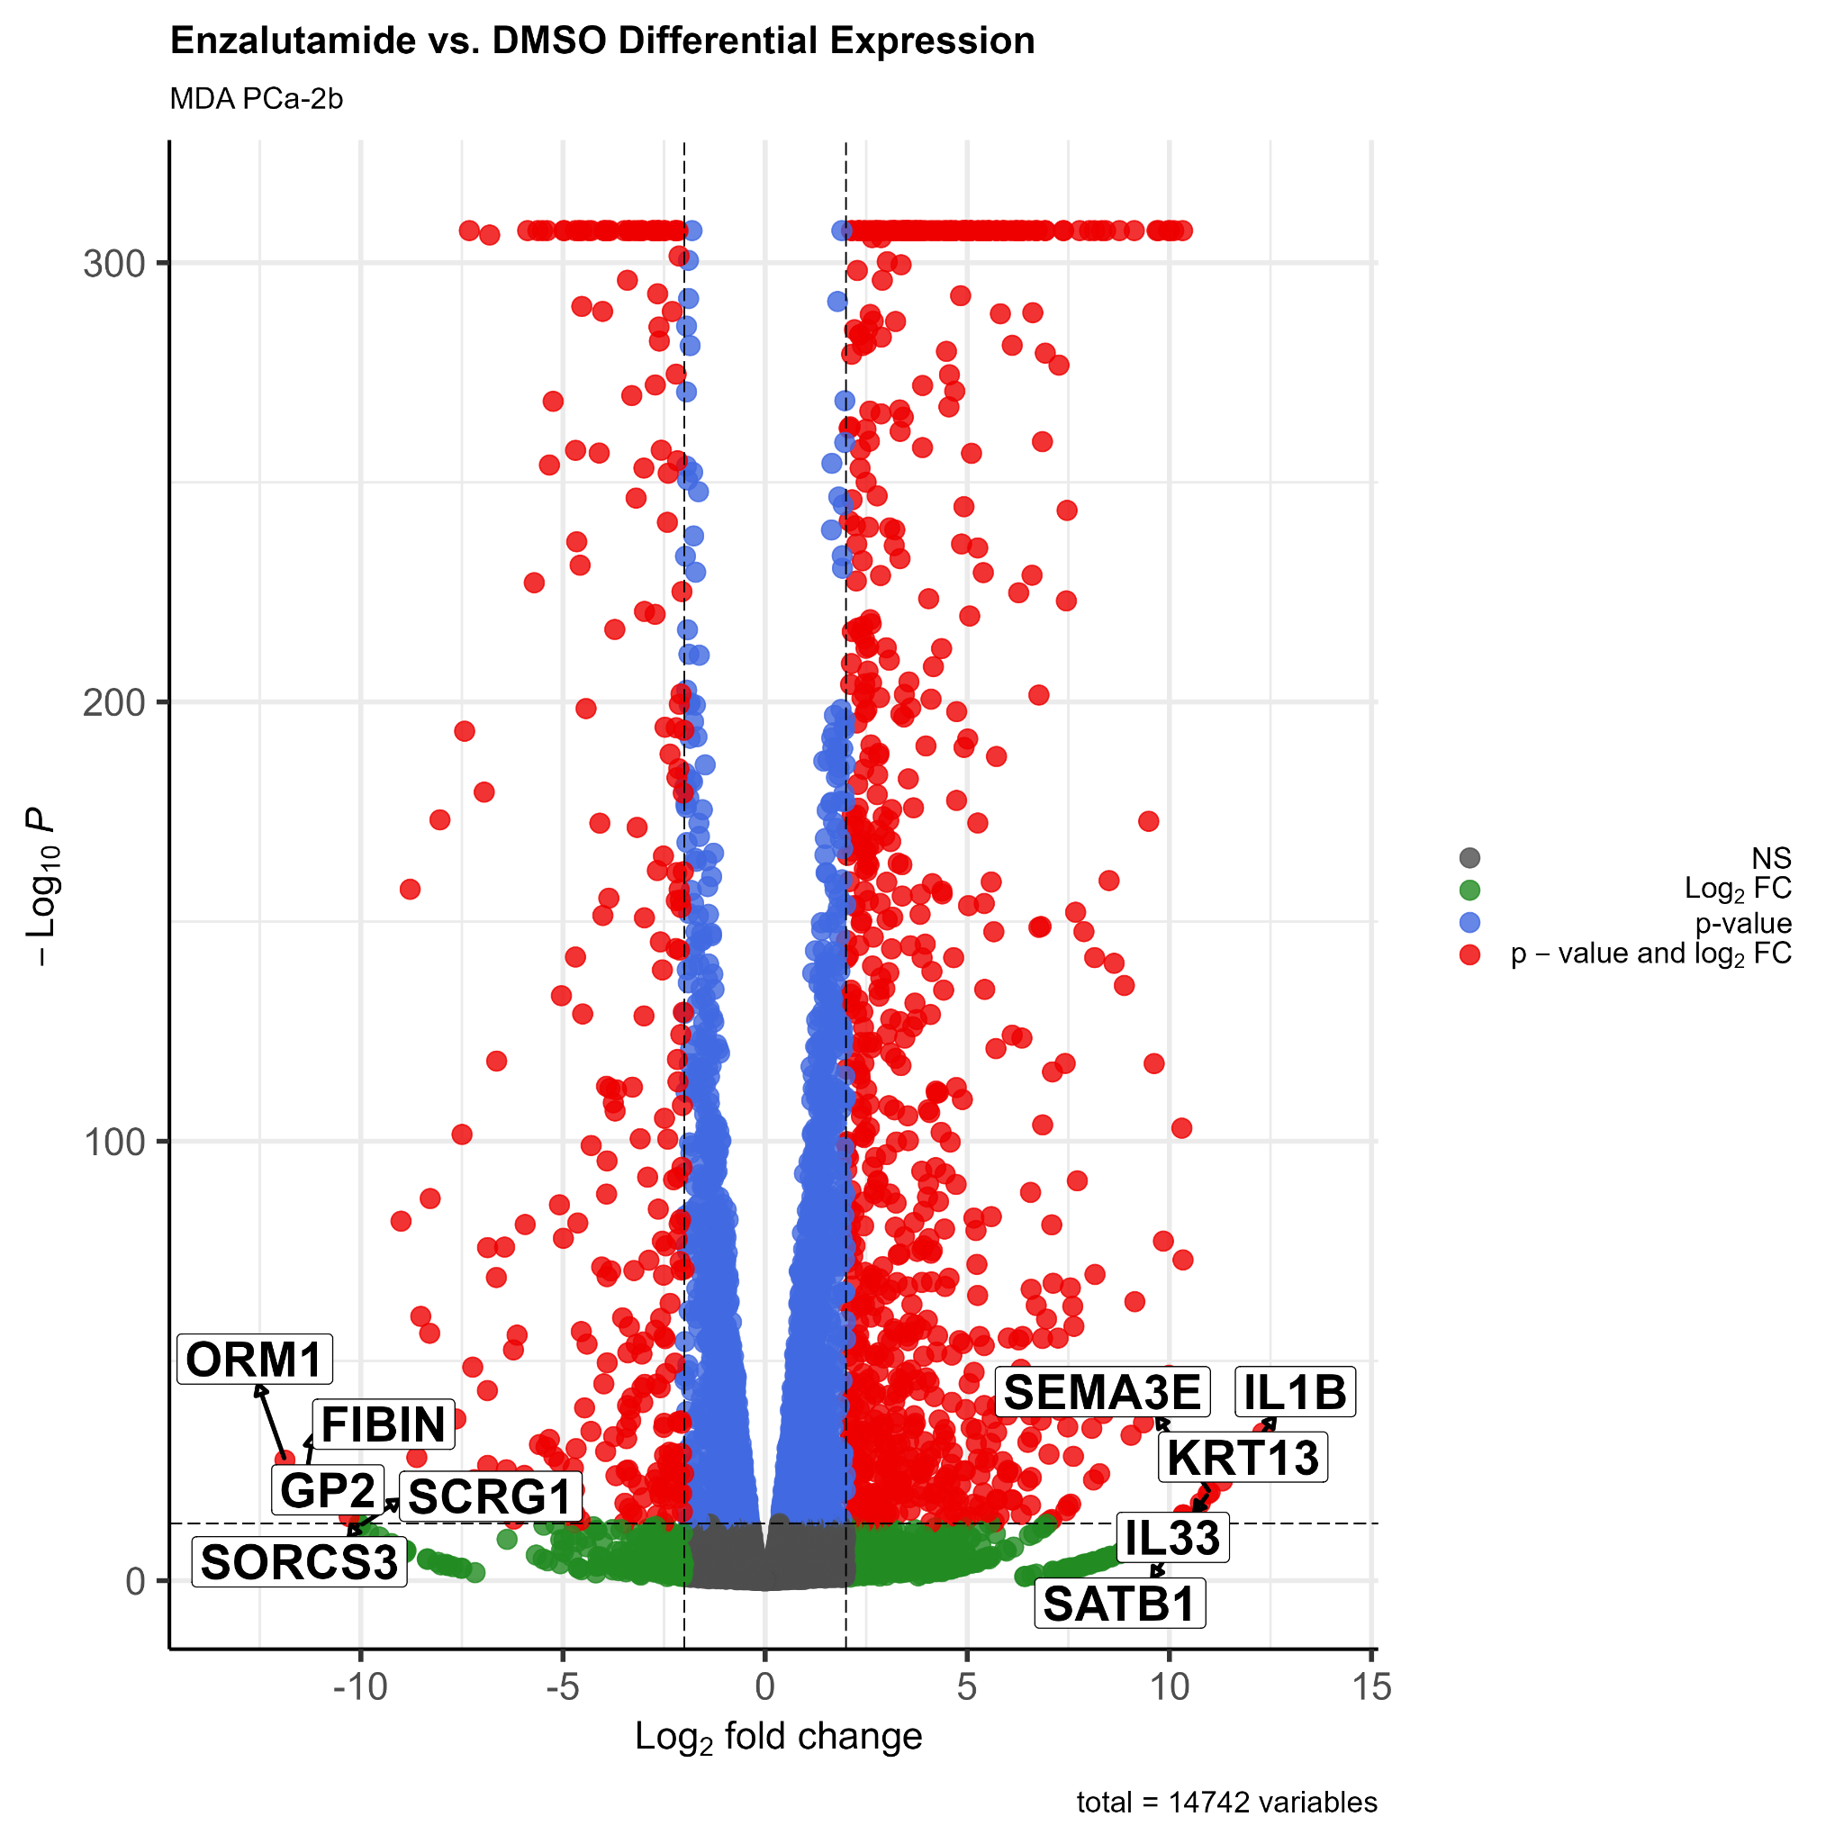
Differential Expression Analysis Reveals Druggable Genes

Slide 7
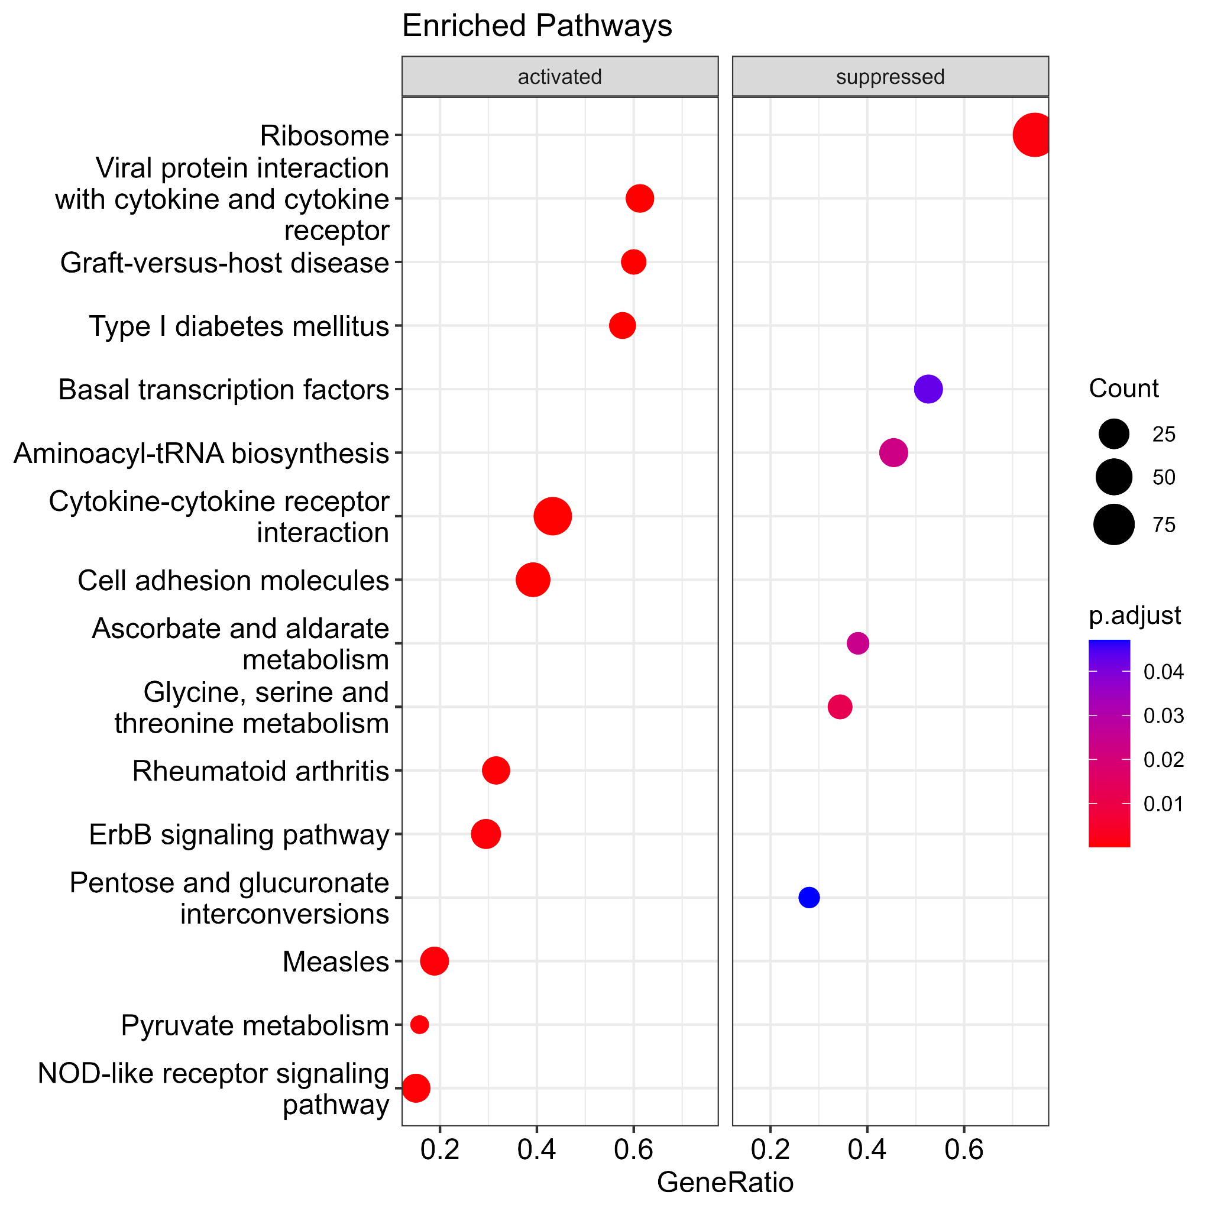
How can we use previously collected data to as motivation for new experimentation?
Identify enriched pathways
Narrow focus to one pathway
Investigate the mechanisms of the chosen path

Slide 8
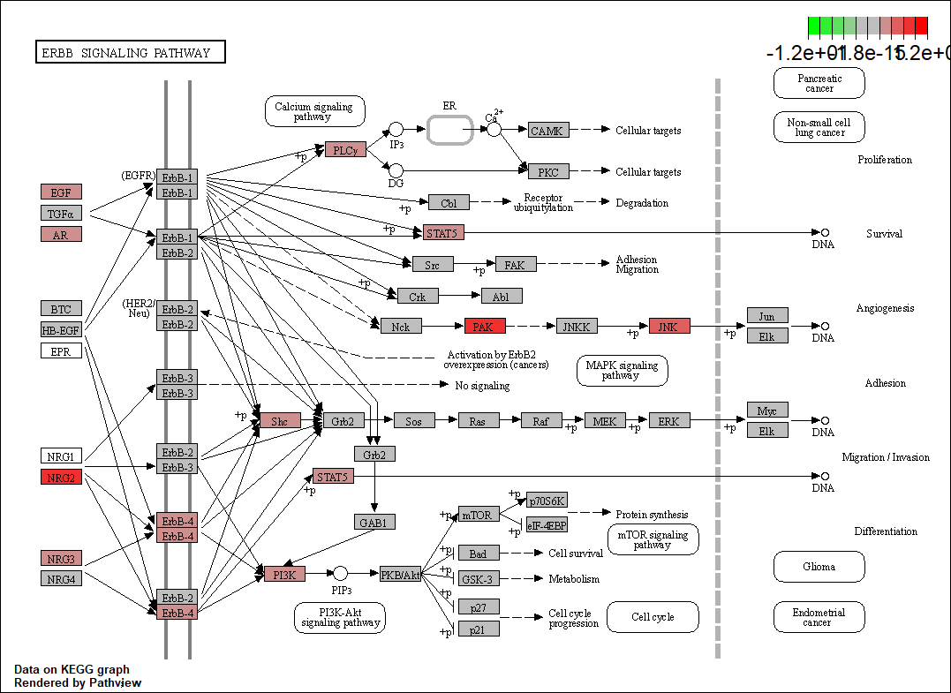

Slide 9
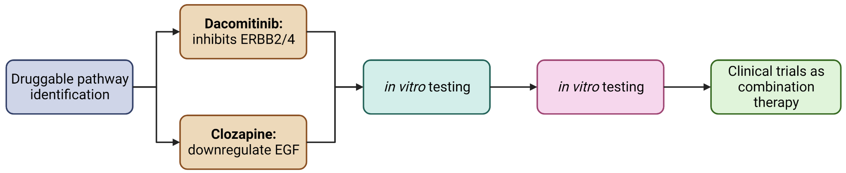
Experimental Design

Slide 10
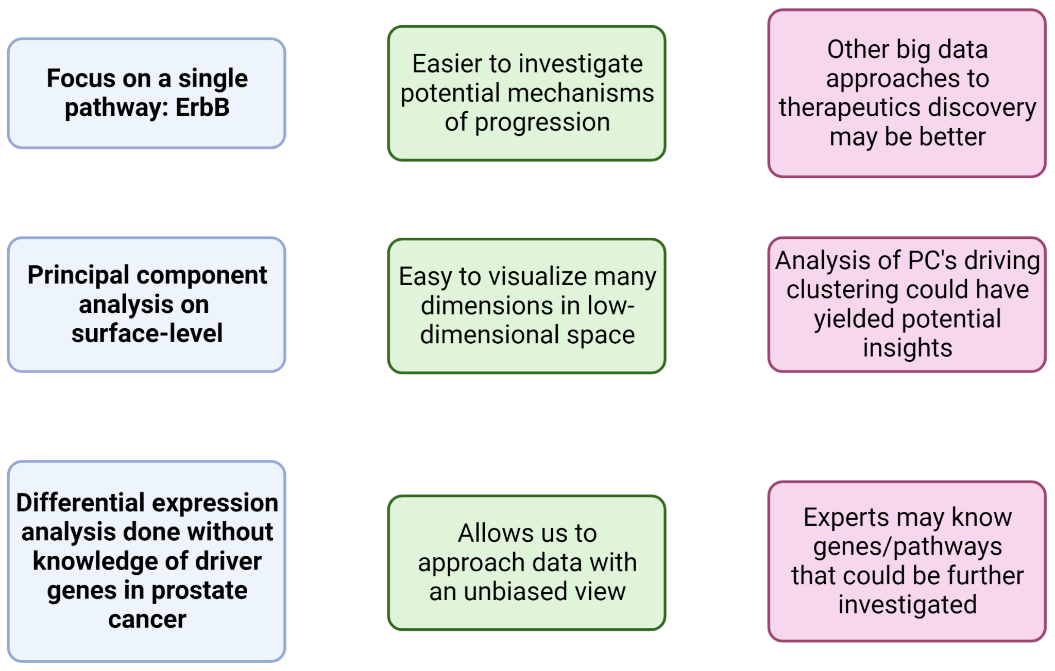
Advantages and Disadvantages of our Approach

Slide 11
References
Denmeade SR, Isaacs JT. A history of prostate cancer treatment. Nat Rev Cancer. 2002 May;2(5):389-96. doi: 10.1038/nrc801. PMID: 12044015; PMCID: PMC4124639.
Kobayashi, Y., Iwakura, Y., Sotoyama, H. et al. Clozapine-dependent inhibition of EGF/neuregulin receptor (ErbB) kinases. Transl Psychiatry 9, 181 (2019). https://doi.org/10.1038/s41398-019-0519-1
Lowder D, Rizwan K, McColl C, Paparella A, Ittmann M, Mitsiades N, Kaochar S. Racial disparities in prostate cancer: A complex interplay between socioeconomic inequities and genomics. Cancer Lett. 2022 Apr 10;531:71-82. doi: 10.1016/j.canlet.2022.01.028. Epub 2022 Feb 3. PMID: 35122875; PMCID: PMC9701576.
Siegel, RL, Miller, KD, Wagle, NS, Jemal, A. Cancer statistics, 2023. CA Cancer J Clin. 2023; 73(1): 17-48. doi:10.3322/caac.21763\
https://www.selleckchem.com/products/pf299804.html
Data and Code Availability: https://github.com/saipra003/mini-dream_nci_dcb_summer_2023

Slide 12
Questions?

